Slide 1
CS 117 Winter 2011 Wednesday Jan 19
Bluetooth
Tanenbaum Chpt 4, pg 310-317
Also:
“Enhancing Bluetooth TCP Throughput ..”
Ling-Jyh Chen, et al - ICC 2004
“BlueTorrent: Cooperative Content Sharing ..”
Sewook Jung, etc - Percon 2007

Slide 2

Bluetooth:
Where does the name come from?

Slide 3
Bluetooth working group history
February 1998: The Bluetooth SIG is formed
promoter company group: Ericsson, IBM, Intel, Nokia, Toshiba
May 1998: Public announcement of the Bluetooth SIG
July 1999: 1.0A spec (>1,500 pages) is published
December 1999: ver. 1.0B is released
December 1999: The promoter group increases to 9
3Com, Lucent, Microsoft, Motorola
March 2001: ver. 1.1 is released
Aug 2001: There are 2,491+ adopter companies
Nov 2004: ver. 2.0 is released
Support EDR (Enhanced Data Rate) up to 3Mbps

Slide 4
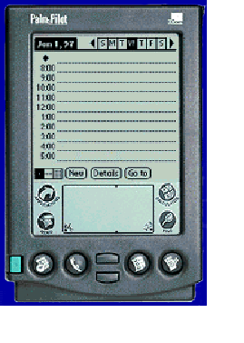

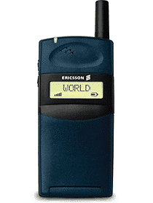
What does Bluetooth do for you?
Synchronization
Automatic synchronization of calendars, address books, business cards
Push button synchronization
Wireless keyboard
Proximity operation

Slide 5
Cordless Headset
Cordless
headset
User benefits
Multiple device access
Cordless phone benefits
Hands free operation

Slide 6
Putting it all together..
Landline
Cable Replacement
Data/Voice Access Points
…and combinations!
Personal Ad-hoc Networks
Notes:
Main usage models targeted during development:
Internet Bridge (one interface towards PSTN, ISDN, LAN, xDSL, GSM,…)
Synchronisation
The ultimate headset
Briefcase trick (hidden computing)
Control laptop in briefcasefrom mobile phone
Three in one phone (Office, home, cellular)
Speaking laptop (use laptop as speakerphone)
Instant Postcard
Conference table

Slide 7
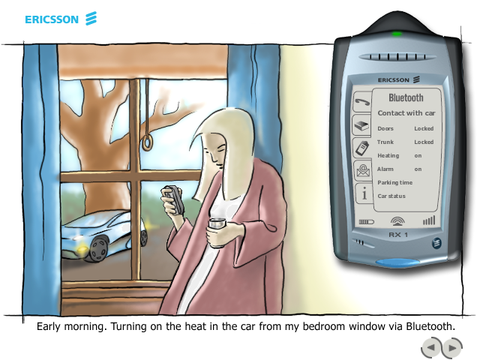
Example...

Slide 8
Bluetooth Physical link
Point to point link
master - slave relationship
radios can function as masters or slaves
m
s
Piconet
Master can connect to 7 slaves
Each piconet has max capacity =1 Mbps
hopping pattern is determined by the master
m
s
s
s

Slide 9
Bluetooth radio link
1MHz
. . .
1
2
3
79
83.5 MHz
frequency hopping spread spectrum
2.402 GHz + k MHz, k=0, …, 78
1,600 hops per second
GFSK modulation
1 Mb/s symbol rate
transmit power
0 dBm (up to 20dBm with power control)

Slide 10
Connection Setup
Inquiry - scan protocol
to learn about the clock offset and device address of other nodes in proximity

Slide 11
Inquiry on time axis
f1
f2
Slave1
Inquiry hopping
sequence
Master
Slave2

Slide 12
Piconet formation
Page - scan protocol
to establish links with nodes in proximity
Master
Active Slave
Parked Slave
Standby

Slide 13
Addressing
Bluetooth device address (BD_ADDR)
48 bit IEEE MAC address
Active Member address (AM_ADDR)
3 bits active slave address
all zero broadcast address
Parked Member address (PM_ADDR)
8 bit parked slave address

Slide 14
Piconet MAC protocol : Polling
FH/TDD
f1
f2
f3
f4
f5
f6
m
s1
s2
625 µsec
1600 hops/sec

Slide 15
Multi slot packets
FH/TDD
f1
f4
f5
f6
m
s1
s2
625 µsec
Data rate depends on type of packet

Slide 16
Physical Link Types
Synchronous Connection Oriented (SCO) Link
slot reservation at fixed intervals
Asynchronous Connection-less (ACL) Link
Polling access method
SCO
ACL
ACL
SCO
ACL
SCO
ACL
SCO
ACL
SCO
SCO
ACL
m
s1
s2
Notes:
If there is no data to be sent on the ACL link and no polling is required, no transmission shall take place.
If a slave fails to decode the slave address in the packet header, it is not allowed to transmit in the next slot.
However, on an SCO link, the slave can go ahead and transmit in its allocated slot even if the decoding fails in the preceding slot.
SCO slave shall not transmit in its allocated slot if a different slave was addressed in the previous master-to-slave slot.
A collision can happen when a slave incorrectly decodes a packet addressed to another slave and responds

Slide 17
Packet Types
Control
packets
Data/voice
packets
Voice
data
ID*
Null
Poll
FHS
HV1
HV2
HV3
DV
DM1
DM3
DM5
DH1
DH3
DH5
Notes:
Add channel mapping discussion here:
Link Control Channel (packet header)
Link Management channel
L2CAP
SCO

Slide 18
Packet Format
72 bits
54 bits
0 - 2744 bits
Access
code
Header
Payload
Voice
header
Data
CRC
No CRC
No retries
ARQ
FEC (optional)
FEC (optional)
625 µs
master
slave
Notes:
Mention that over SCO link you cannot carry any other real-time traffic. There is no protocol-id field in the SCO header/payload. Is this really true?

Slide 19
Access Code
72 bits
Access
code
Header
Payload
Purpose
Types
Channel Access Code (CAC)
Device Access Code (DAC)
Inquiry Access Code (IAC)
Synchronization
DC offset compensation
Identification
Signaling
X

Slide 20
Packet Header
54 bits
m
Access
code
Header
Payload
s
s
s
Purpose
Addressing (3)
Packet type (4)
Flow control (1)
1-bit ARQ (1)
Sequencing (1)
HEC (8)
Max 7 active slaves
16 packet types (some unused)
Broadcast packets are not ACKed
For filtering retransmitted packets
Verify header integrity
total
18 bits
Encode with 1/3 FEC to get 54 bits
Notes:
How useful is header protection when payload is unprotected

Slide 21
Voice Packets (HV1, HV2, HV3)
72 bits
54 bits
240 bits
= 366 bits
Access
code
Header
30 bytes
Payload
HV1
10 bytes
+ 1/3 FEC
HV2
20 bytes
+ 2/3 FEC
HV3
30 bytes
3.75ms (HV3)
2.5ms (HV2)
1.25ms (HV1)

Slide 22
Data rate calculation: DM1 and DH1
625 µs
72 bits
54 bits
240 bits
= 366 bits
Access
code
30 bytes
Header
Payload
Dir | Size | Freq | Rate
↑ | 17 | 1600/2 | 108.8
↓ | 17 |  | 108.8
↑ | 27 |  | 172.8
↓ | 27 |  | 172.8
DM1
1
17
2/3
FEC
2
DH1
1
27
2
625 µs
1
2

Slide 23
Data rate calculation: DM3 and DH3
1875 µs
72
bits
54
bits
1500 bits
= 1626 bits
Access
code
Header
187 bytes
Payload
Dir | Size | Freq | Rate
↑ | 121 | 1600/4 | 387.2
↓ | 17 |  | 54.4
↑ | 183 |  | 585.6
↓ | 27 |  | 86.4
DM3
2
121
2
2/3
FEC
DH3
2
183
2
1875 µs
1
2
3
4

Slide 24
Data rate calculation: DM5 and DH5
3125 µs
72
bits
54
bits
2744 bits
= 2870 bits
Access
Code
343 bytes
Header
Payload
Dir | Size | Freq | Rate
↑ | 224 | 1600/6 | 477.8
↓ | 17 |  | 36.3
↑ | 339 |  | 723.2
↓ | 27 |  | 57.6
DM5
2
224
2
2/3
FEC
DH5
2
339
2
3125 µs
625 µs
1
2
3
4
5
6

Slide 25
Data Packet Types
Symmetric
Asymmetric
DM1
108.8 | 108.8 | 108.8
258.1 | 387.2 | 54.4
286.7 | 477.8 | 36.3
DM3
2/3 FEC
DM5
Symmetric
Asymmetric
No FEC
DH1
172.8 | 172.8 | 172.8
390.4 | 585.6 | 86.4
433.9 | 723.2 | 57.6
DH3
DH5

Slide 26
Inter piconet communication
Cordless
headset
mouse
Cordless
headset
Cell phone
Cell phone
Cell phone
Cordless
headset

Slide 27
Scatternet

Slide 28
Scatternet, scenario 2
How to schedule presence in two piconets?
Forwarding delay ?
Missed traffic?

Slide 29
Baseband: Summary
Device 1
Device 2
L2CAP
L2CAP
LMP
Data link
LMP
Baseband
Baseband
Physical
TDD, frequency hopping physical layer
Device inquiry and paging
Two types of links: SCO and ACL links
Multiple packet types (multiple data rates with and without FEC)

Slide 30
Link Manager Protocol
Applications
IP
SDP
RFCOMM
Control
Data
Setup and management
of Baseband connections
Piconet Management
Link Configuration
Security
Audio
L2CAP
Link Manager
LMP
Baseband
RF

Slide 31
Piconet Management
Attach and detach slaves
Master-slave switch
Establishing SCO links
Handling of low power modes ( Sniff, Hold, Park)
Paging
m
s
s
s
req
Master
Slave
response

Slide 32
Low power mode (hold)
Hold offset
Slave
Hold duration
Master

Slide 33
Low power mode (Sniff)
Sniff offset
Sniff duration
Slave
Sniff period
Master
Traffic reduced to periodic sniff slots

Slide 34
Low power mode (Park)
Slave
Beacon instant
Master
Beacon interval
Power saving + keep more than 7 slaves in a piconet
Give up active member address, yet maintain synchronization
Communication via broadcast LMP messages

Slide 35
Case study I: Enhancing Bluetooth TCP Throughput via Packet Type Adaptation ICC 2004 Paris, June 2004
Ling-Jyh Chen, Rohit Kapoor, M. Y. Sanadidi, Mario Gerla
Dept. of Computer Science, UCLA
Copy of the paper is posted on Course Web

Slide 36
Outline
The problem: Wireless interference and bit errors severely affect TCP efficiency.
The opportunity: Bluetooth offers multiple packet type options with different FEC and packet lengths. Moreover, the link layer API provides link error quality information. Opportunity for cross-layer adaptation.
Key idea: dynamically select packet type based on measured link quality.
The results: we show that the “Adaptive Packet Type” approach in Bluetooth can effectively enhance TCP performance.

Slide 37
Data Packet Types
Symmetric
Asymmetric
DM1
108.8 | 108.8 | 108.8
258.1 | 387.2 | 54.4
286.7 | 477.8 | 36.3
DM3
2/3 FEC
DM5
Symmetric
Asymmetric
No FEC
DH1
172.8 | 172.8 | 172.8
390.4 | 585.6 | 86.4
433.9 | 723.2 | 57.6
DH3
DH5

Slide 38
Bluetooth packet types
DH: Stop and Wait ARQ
DM: ARQ as well as 2/3 FEC codes to correct single bit errors
FEC coding scheme:
(15, 10) Hamming code,
each block of 10 information bits is encoded into a 15 bit codeword
can correct a single bit error in each block.

Slide 39
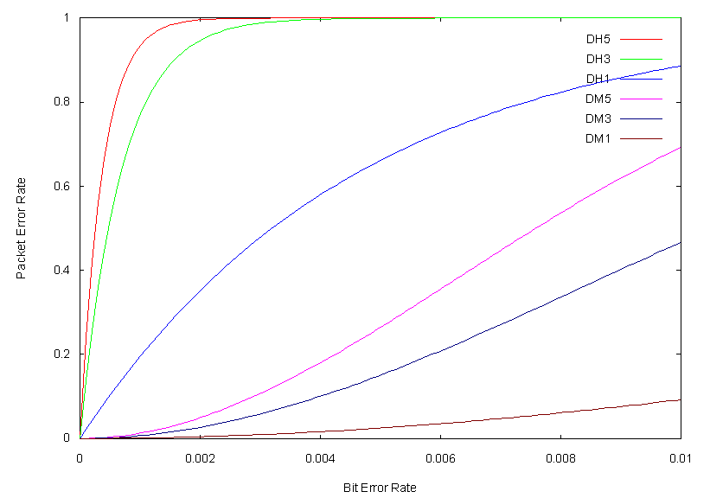
PER vs BER
Notes:
PER: Packet Error Rate; BER: Bit Error Rate

Slide 40
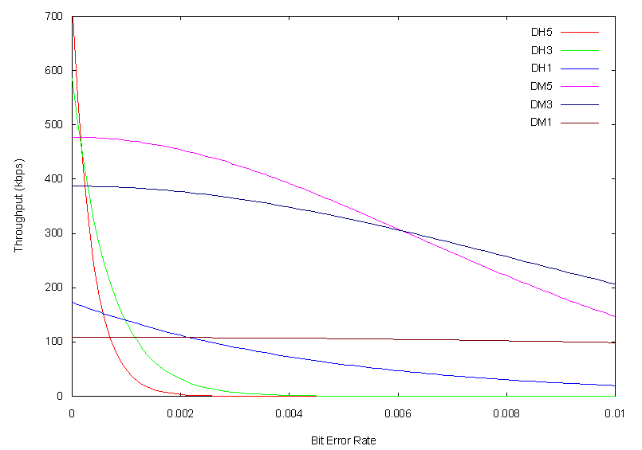
Bluetooth Throughput
Mode | BER range
DH5 | <0.0001529
DM5 | >0.0001529, and <0.0060795
DM3 | >0.0060695, and <0.0157813
DM1 | >0.0157813

Slide 41
Proposed Approach
Adaptive Packet Type (APT):
In BT specs, the function call, Get_Link_Quality, returns the Quality of the specified Link.
We read the returned link Quality Value, and adapt packet type so as to optimize throughput.

Slide 42
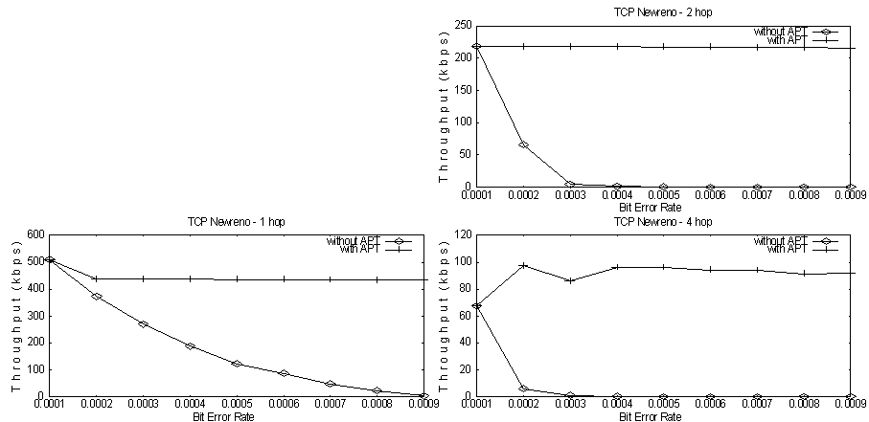
Simulation 1: Fixed BER
Time: 600 seconds TCP Packet Size: 500 bytes Buffer Size: 9000 bytes

Slide 43
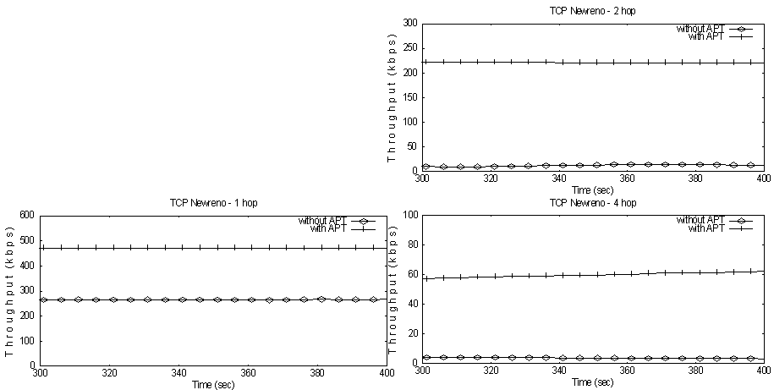
Simulation 2: Varying BER
Time: 600 seconds TCP Packet Size: 500 bytes Buffer Size: 9000 bytes BER: changes between 0.0001 and 0.0005 every 1 second

Slide 44
BlueTorrent: P2P content sharing with Bluetooth
Mario Gerla
Sewook Jung
Uichin Lee
Network Research Lab.
UCLA

Slide 45
People-2-People Content Sharing
Scenarios of interest
Downloading newspaper, news clips, music on the way to the subway
7 degrees of Separation (Columbia Univ.)
Proximity Advertisement
Listen to music - Nokia-EMI
Advertisement – Bluecasting, WideRay
“Reading” billboards – CBS
Exchanging songs, pictures, ads, movie clips
Social networking - Nokia Sensor

Slide 46



Target Scenario
Airport Corridor, Subway platform
Multiple Bluetooth Access Points
Proximity data transfers
Access Point
Access Point

Slide 47
P2P Data Transfers in Bluetooth
Piconets
1-to-1 connection for P2P
up to 7 slaves
Scatternet (?)
Hardware Limitation
Some chips support only limited scatternet
Software Limitation
No specification
Mobility problem
Disconnection, Reconfiguration
Bluetooth Overlays
M
S
Piconet (1-to-1, Peer-to-peer)
M
S
S
…
S
Piconet
M
M
S
SB
MB
S
S
Scatternet

Slide 48
The Overlay Concept
Piconet Members move together (Group Mobility)
Each Piconet represents a “nomadic warrior”
Works also with single node Piconets
Opportunistic neighbor Piconet merge => Overlay BT
Result: Virtual Scatternet
D1
S3
D1
S3
S1
D2
S2
D3
S1
D2
S2
D3
(a) Slave Stage
(b) Probe Stage
D1
S3
D1
S3
S1
D2
S2
D3
S1
D2
S2
D3
(c) Return Stage
(d) Overlay BT
Master Node
S_ : Source
Slave Node
D_ : Destination
Probe Node
Free Node

Slide 49
Problem
Provide an “effective” content sharing mechanism for Bluetooth users

Slide 50
Enter: BlueTorrent
BlueTorrent
Bluetooth P2P Application
Sharing small size audio/video files (<10MB)
Download data from digital billboards on the street with BT-AP transfer
Exchange data with BT-BT transfer after receiving from AP

Slide 51
BlueTorrent (cont)
New contribution:
P2P transfer (commercial products support only AP-BT transfer - example Bluecasting)
To complete download, must help others (same as in BitTorrent)
Performance measures:
Download percentage
Download finish time

Slide 52

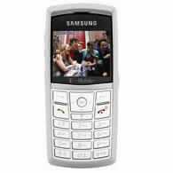
BlueCasting
B
B
B
C
C
C
A
A
A
D
D
D

Slide 53
BlueTorrent
B
B
B
C
C
C
A
A
A
D
D
D

Slide 54
BlueTorrent vs. Bluecasting
Out of Range User
Bluetooth Access Point
Data cannot be downloaded
Download from Access Point
(A) BLUECASTING = AP only Transfer
Out of Range User
Bluetooth Access Point
Download to Out of Range User
Download from Access Point
Bluetooth Node
(B) BlueTorrent P2P Transfer
Bluetooth Link

Slide 55
BlueTorrent Architecture
BlueTorrent core components
Query processor
Data collector
Peer manager
BlueTorrent user interface
App. Layer

Slide 56
Query Processor
Query types (push/pull)
Only APs can “push” the index to users passing by
Regular users send “pull” type query to find the index info. of the interested file
Index information
Unique file ID (e.g., 32bit hash)
Title, producer, media type
User interface allows to send queries to neighbors
E.g., title: “Pirates & Caribbean” media type: avg/mpg

Slide 57
Data Collector / Peer Manager
Data Collector
BitTorrent-style file swarming
A file is divided into “k” pieces
Procedure
A new connection is announced to the data collector
Exchange bitmap vector to find missing pieces
Download missing pieces
Peer Manager
Run periodic inquiry procedure to find peers
Find the best peer to download based on connection history

Slide 58
Peer Discovery Procedure
Inquiry (master) and scan (slave) pair to make a connection
Bluetooth was originally developed for “cable replacement”
Inquiry discovery procedure
A sends inquiry packet trains (window size is multiple of 1.28s)
B receives an inquiry packet
B backs off by a random interval over [0,1023]
B sends back an “inquiry response packet”
Master
(1)
(2)
(4)
Slave
(3)

Slide 59
Simulation Setup
NS-2 + UCBT extension
Corridor mobility model:
Rectangle Area (length >> width)
Two directions (West -> East, East -> West)
Constant speed randomly selected over [0, V_{max}]
When reaching the bounds:
North or South: nodes are mirrored back to the area
West or East bound: nodes are restarted
Reset mode: user data is cleared (acting as a new node)
No-reset mode: user data is retained (re-enter the area)
Mobility Setting:
# of nodes: 25, 50, 75, 100 (Default: 50 nodes)
V_{max} =0.0 (static), 0.4, 0.8, 1.2, 1.6 m/s
Area: [25, 50, 100] x [3,5] m² (Default: 100x5 m²)

Slide 60
Simulation Setup (Cont)
Test scenarios: AP mode vs. P2P mode
AP mode: data is only transferred from AP to nodes
Periodic inquiry mode with inquiry scan interval (0.64s) and scan period [0.64s, 4s]
Distribute 1.2MB files
Divided by 50, 100, 200 blocks (# of blocks)
Metrics
Percentage of nodes that successfully downloaded the file in a given time
No-reset: the total number of exposed nodes remains the same
Reset: the number of exposed nodes keeps changing
Fresh nodes come in continuously…

Slide 61
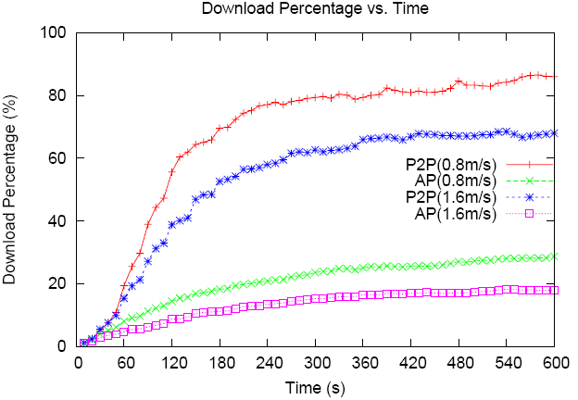
Simulation Result (1) Download Percentage vs. Time (reset)
Reset – a new node enters after a node moves out of area
Speed is critical: as speed increases, download %age decreases
P2P
AP

Slide 62
Experiment Setup
BlueZ Bluetooth protocol stack for Linux
Bluetake BT009Si (Silicon Wave, Bluetooth v1.2)
3 desktops and 5 laptops (Pentium IV/512MB RAM)
Mobility emulation:
AP is up for a certain period of time; to simulate a node moving out of AP’s range (1 AP vs 7 users)
Move 20m (max AP’s range) at a speed 0.8m/s (=25s)
Only P2P mode can transfer data in AP down period
Speed: 0.8m/s, 1.6m/s, corridor length: 100m
Reset period (i.e., lifetime) is determined by the speed and corridor length
e.g. for 0.8m/s a node is reset after 100m/0.8m/s=125s

Slide 63
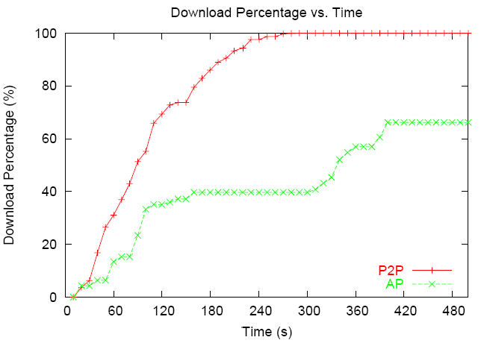
Experiment Result (2) Download Percentage vs. Time (no-reset)
P2P mode is faster than AP only mode

Slide 64
Testbed Experiment Setup
2 Laptops (Master, Slave)
Ackerman Union (w/ Interference, Obstacle)
Speed 1 m/s (5 meter marks)
BT 1.1 ⬄ 1.1
BT 2.0 ⬄ 2.0
master
slave
30M
60M

Slide 65
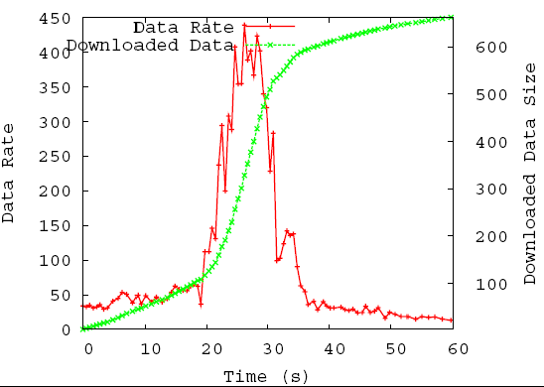
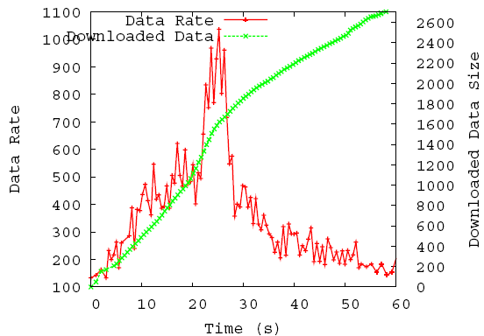
Real Environment Experiment Result
Kbps
KBytes
Kbps
KBytes
BT 1.1 ⬄ 1.1
BT 2.0 ⬄ 2.0
Connection Can be made in 30m distance

Slide 66
Conclusion
Designed and implemented BlueTorrent
Peer manager, Query processor, Data collector
Found the optimal parameter setting for periodic inquiry mode
Showed that P2P networking outperforms the conventional client-server mode (i.e., AP mode)
Feasible in the walking speed range

Slide 67
Future work
Multiple simultaneous downloads (service discovery, scheduling)
Incentives/security
Advertising (e.g., embedding ads in files, like a Mobile-Google)
Urban sensing; harvesting the massive data base
BT vs ZigBee vs WiFI in smart phones

Slide 68
CS 117 Bluetooth Lab Experiments
Measure TCP performance of BT in presence of 802.11 devices and/or noise sources

Slide 69
Bluetooth Experiment Goals
Impact of distance and Bit Error Rate (BER) on throughput.
Effect of one-to-many connection on throughput.
Interference among Bluetooth devices.
Interference and fairness between Bluetooth and IEEE802.11 devices.

Slide 70
Experiments (1)
Measure TCP data throughput using Iperf measurement tool on one-to-one connection at different distance and packet type (DH1, DH3, and DH5).
1st Position
2nd Position
3rd Position
Master
Slave
Slave
Slave
5m (16.4 ft)
10m (32.8 ft)
15m (49.2 ft)

Slide 71
Experiments (2)
Measure TCP data throughput on one-to-two and one-to-four connection.
Slave
Slave
5m (16.4 ft)
5m (16.4 ft)
Master
Master
5m (16.4 ft)
5m (16.4 ft)
5m (16.4 ft)
5m (16.4 ft)
Slave
Slave
Slave
Slave
One-to-two Connection
One-to-four Connection

Slide 72
Experiments (3)
Measure TCP data throughput in four crossed one-to-one connections.
Master
Master
Slave
Master
5m (16.4 ft)
Slave
Master
Slave
Slave

Slide 73
Experiments (4)
Measure TCP data throughput for one-to-one connection crossed by IEEE 802.11 transfer.
IEEE 802.11
Master
Slave
IEEE 802.11

